Slide 1
Mediation Background
Ilana Trumble
October 9, 2018

Slide 2
Mediation Background
M
(metabolites)
a
b
X
(microbiome)
Y
(HNSCC)
c

Slide 3
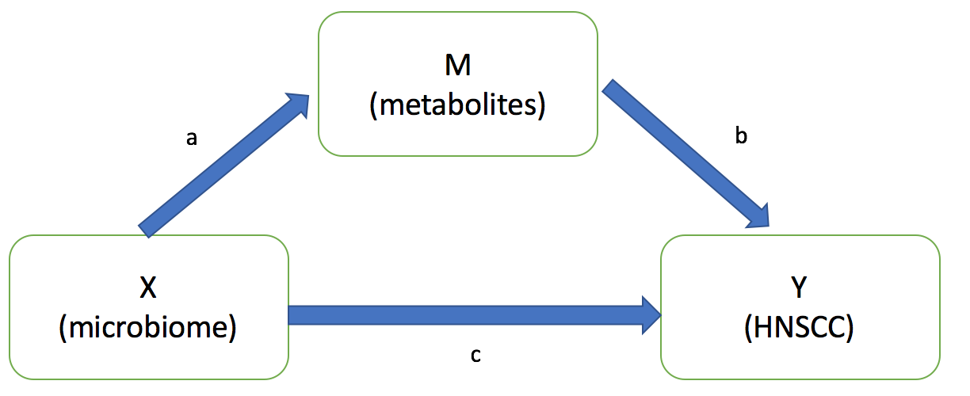
Mediation Analysis Introduction
Traditional steps for mediation analysis (Baron and Kenny, 1986)
3 steps of regression:
X -> Y *
X -> M
X + M -> Y
Judge if regression coefficient is significant for M1 and M2. If so, conclude mediation could exist.
If mediation exists, effect of X on Y in M3 will weaken compared to M1
Could be any kind of regression models
To test if mediation effect is statistically significant, Sobel test was traditionally used. Bootstrapping has been found to have higher power
Bootstrapping R package ’mediation’ outputs ACME (average causal mediation effects). If significantly different from 0, mediation is significant.
Terminology: “full” (no c) and “partial” (some c) mediation

Slide 4
Myths and Truths about Mediation Analysis (2011)
2 points of dispute:
Strength of mediation should be measured by size of indirect effect (a x b), not lack of direct effect (c)
Argument: c’= (a x b) + c. If c and (a x b) have opposite signs, there is competitive mediation, and c’ may be close to 0 even though mediation does exist.
M1 does not need to have a significant effect
New terminology: complementary mediation, competitive mediation, indirect only mediation, direct only effect, no-effect
X
(microbiome)
Y
(HNSCC)
C’

Slide 5
What mediation analysis cannot do (2011)
A significant mediation result does not prove M is a mediator
We test the significance of the effect size, assuming it is an actual mediator.
Causal role cannot be determined by statistical analysis alone. Design factors must be employed.

Slide 6
Miranda’s Project
Aim 1: Develop and test a global intersection union test (gIUT) for modeling microbiome, metabolome, and outcome data under a mediation framework.
To assess mediation, use established causal steps approach (?)
Incorporate regression approaches that can handle high dimensional predictors and mediators
Aim 2: Develop and test multiple estimators for the indirect effect of the microbiome – metabolome – outcome relationship relationship using a mediation framework
To assess mediation, estimate the indirect effect of exposure on outcomes, acting through mediating variable
2 estimators for indirect effect of microbiome: 1) global estimate of indirect effect (GIE) and 2) taxon-specific estimates of the indirect effect (TIE)
Expect to be more powerful than gIUT in some circumstances
Type I error and power of proposed methods will be assessed through simulations

Slide 7
Moving forward
Timeline: develop and test functions for simulation studies (months 1-2), pilot a small round of simulations (month 3), complete simulations and analyze findings (months 4-6), apply findings to HNSS data (months 7-8), dissemination of findings (months 9-12)
Ilana’s next steps:
Read “prior work” that extends traditional mediation models to models with a set of correlated high-dimensional exposure variables (citation 28). Read other relevant references.
Read, understand, and summarize Novel Methodology section of proposal (nitty gritty math details, includes description of simulations).
Learn about LASSO regression and data integration

